Slide 1

Deepfake Defense in Biometric Authentication
School of Computer Science and Engineering
Submitted By: Kanakpreet Kaur (2427030168), sec-K
Supervised By: Dr. Susheela Bishnoi

Slide 2





Presentation Outline
Introduction
Literature Review
Research Gaps
Proposed Solution
Objectives

Slide 3
Introduction: The Deepfake Threat
Biometric authentication (face, voice, fingerprint) is a cornerstone of modern digital security, widely trusted for its accuracy and convenience in tasks from unlocking smartphones to authorizing transactions.
However, the rise of generative AI has enabled attackers to use deepfake highly realistic synthetic images, videos, and voices to bypass these systems.
A fake video or AI-generated voice can trick systems into granting unauthorized access, posing a critical new threat.

Slide 4
Literature Review: Deepfakes & Vulnerabilities
CNN models trained on manipulated face datasets.
High accuracy but require large datasets.
Frequency Domain Analysis
Detects unnatural patterns in pixel distribution.
Works well for compressed videos.
Eye Blinking & Facial Landmark Detection
Deepfakes often fail to mimic natural blinking patterns.
Deepfake Detection using CNNs
GAN-based Detection
Identifies artifacts left by Generative Adversarial Networks.

Slide 5
LITERATURE REVIEW:
YEAR | OBJECTIVE | DATASET(s) USED | KEY FINDINGS/ INSIGHTS
2024 | Multimodal deepfake detection for short videos by correlating audio and lip motion | FakeAVCeleb, DFDC, DeepFakeTIMIT | Their “late fusion +multi view” approach on short clips showed better detection in constrained video snippets, especially under limited compute settings
2024 | Audio-visual fusion with dynamic weighting in transformers | FakeAVCeleb, DFDC, DeepFakeTIMIT | The proposed dual transformer architecture with dynamic fusion improved performance across intra and cross dataset evaluations, showing that Adaptively weighting modalities is beneficial.
2025 | General multimodal framework via cross-modal alignment and distillation(CAD) | Multimodal video datasets with audio+ video | CAD uses a cross-modal alignment module plus distillation to reconcile conflicts in used features. It shows improved robustness over naïve fusion.
2025 | Multimodal detection using transformer +LLM strategies | FakeAVCeleb, benchmark corpora | A transformer/LLM based fusion of the video, audio and textual metadata showed better generalization and consistency in detecting forged content, especially when textual cues exist.
2025 | Local+ global feature fusion in audio visual deepfake detection. | Multimodal audio-visual datasets | Their framework considers both fine-scale(e.g. lip,eye region ) and global facial features, improving detection especially for subtle forgeries.

Slide 6
RESEARCH GAP AND INNOVATION:
Research Gap:
Most deepfake detection models focus on social media or video analysis.
Limited solutions are designed specifically for biometric authentication systems.
Existing models are often heavy and not optimized for real-time deployment.
Our Innovation:
Integrates deepfake detection directly into biometric login systems.
Lightweight CNN-based model suitable for real-time authentication.
Deployable as a web-based security layer using Flask.

Slide 7
PROBLEM STATEMENT
Biometric authentication systems (face recognition) are widely used for secure access. However, advanced deepfake technology can generate realistic fake facial images that may bypass these systems.
Traditional biometric models verify identity but do not check whether the input image is real or AI-generated.
Objective:
To develop a deepfake detection system that enhances biometric authentication by identifying manipulated facial inputs before access is granted.

Slide 8
OBJECTIVES
To develop a system that detects deepfake facial images.
To enhance biometric authentication security.
To integrate deepfake detection with face recognition systems.
To prevent unauthorized access using AI-generated fake faces.
To build a lightweight, real-time deployable model using OpenCV and CNN.

Slide 9
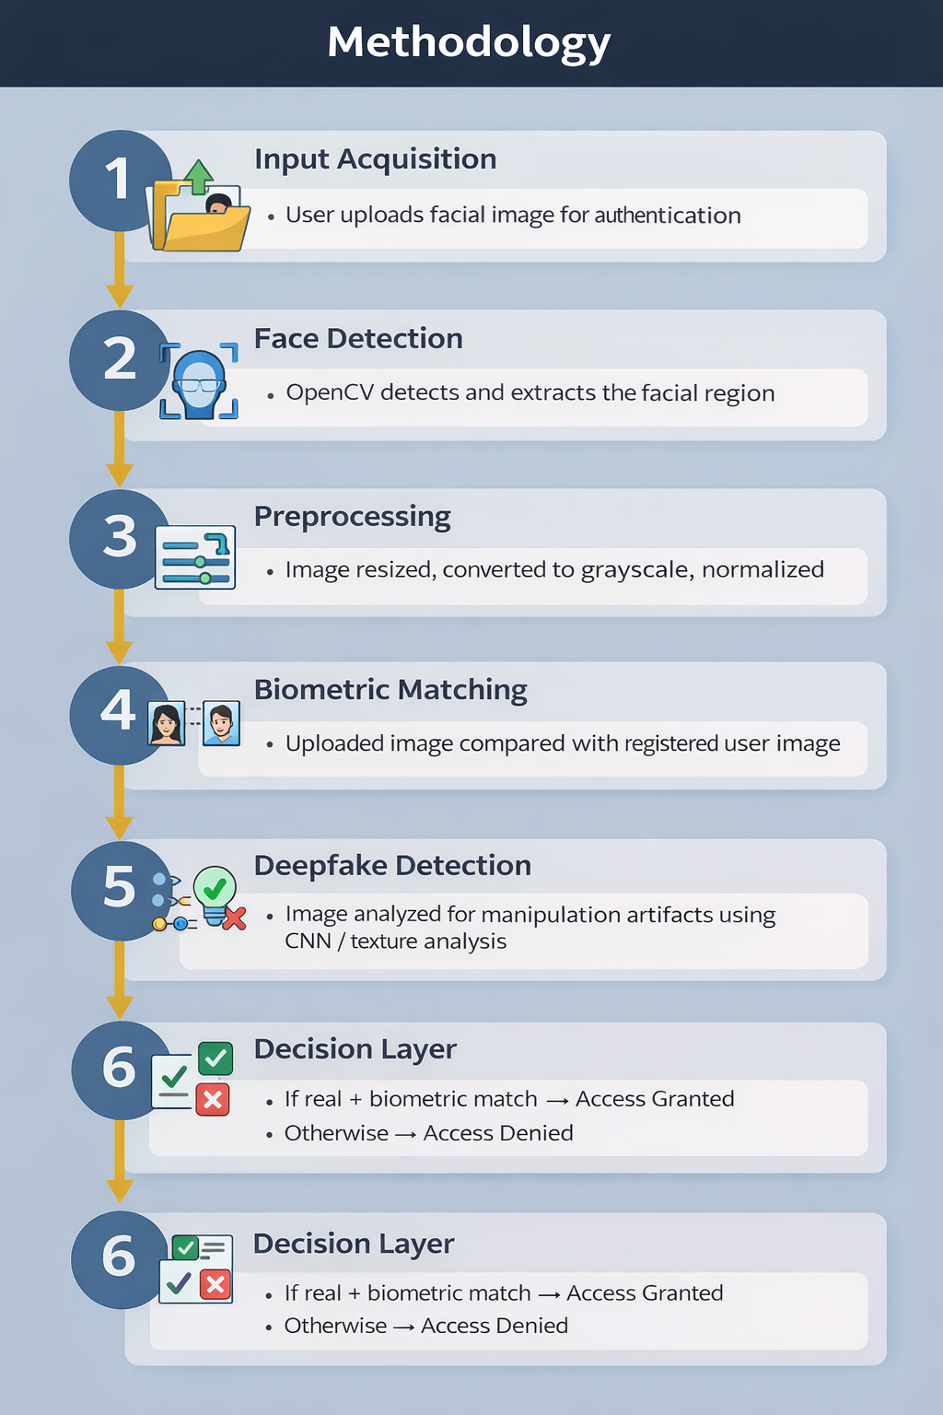
METHODOLOGY
Step 1: Input Acquisition The user uploads a facial image during the authentication process.
Step 2: Face Detection OpenCV is used to detect and extract the facial region from the uploaded image.
Step 3: Preprocessing The extracted face is resized, converted to grayscale, and normalized to prepare it for analysis.
Step 4: Biometric Matching The uploaded facial image is compared with the registered user’s stored biometric image to verify identity.
Step 5: Deepfake Detection The image is analyzed using a CNN-based model or texture analysis techniques to detect manipulation artifacts.
Step 6: Decision Layer If the image is authentic and matches the registered user → Access is Granted. If a deepfake is detected or identity does not match → Access is Denied.

Slide 10
Dataset:
Input Type:
Facial images uploaded during authentication
Image format: JPG / PNG
Dataset Used:
Deepfake Face Dataset (Real vs Fake images)
Preprocessed facial images resized to 224x224 pixels
Preprocessing Steps:
Face detection using OpenCV
Image resizing
Normalization
Noise removal

Slide 11
Model / Architecture:
Model Used:
Convolutional Neural Network (CNN)
Architecture Flow:
Input Image
Face Detection (OpenCV)
Convolution Layers
ReLU Activation
Max Pooling
Fully Connected Layer
Softmax Output (Real / Fake)
Output:
Deepfake Detected
Real Image
Deployment:
Flask Web Application
Local Server Testing

Slide 12
AI/ML TOOLS IMPLEMENTED:
Tool / Technology | Purpose | How It Helps Detect Deepfakes
Convolutional Neural Network (CNN) | Deep learning model | Learns facial texture patterns and identifies manipulation artifacts
OpenCV | Image processing | Detects faces, extracts facial region, and preprocesses images
NumPy | Numerical computation | Handles image arrays and matrix operations for model input
TensorFlow / PyTorch | Model training framework | Trains the deep learning model to classify Real vs Fake images
Flask | Web deployment | Integrates the detection model into a real-time authentication system

Slide 13
PROPOSED SOLUTION:
🔹 Key Components:
Face detection using OpenCV
Image preprocessing (resizing, normalization)
CNN-based deepfake classification (Real vs Fake)
Biometric face matching
Final decision layer for access control
🔹 Working Principle:
User uploads facial image for login.
System verifies identity using biometric matching.
Deepfake detection model analyzes authenticity.
Access is granted only if the image is real and identity matches.

Slide 14

REFERENCES
https://www.researchgate.net/publication/393918145_AI_in_Biometric_Security_Enhancing_Accuracy_and_Detecting_Spoofing_in_Facial_and_Voice_Recognition.
He, S., et al. (2025). Identity Deepfake Threats to Biometric Authentication Systems: Public and Expert Perspectives. arXiv preprint arXiv:2506.06825v1.
Karnouskos, S. (2025). Exploring autonomous methods for deepfake detection: A detailed survey. Heliyon, 11(4), e26533.
Chaudhary, N.K., et al. (2025). Advancements in detecting Deepfakes: AI algorithms and future prospects − a review. Discover Internet of Things, 5, 53.
Amerini, I., & Barni, M. (2025). Deepfake Media Forensics: Status and Future Challenges. Journal of Imaging, 11(3), 73.
Petmezas, G., et al. (2025). Video deepfake detection using a hybrid CNN-LSTM-Transformer model for identity verification. Multimedia Tools and Applications.
Javed, M., et al. (2025). Real-Time Deepfake Detection via Gaze and Blink Patterns: A Transformer Framework. Computers, Materials & Continua, 85(1), 1457-1493.
ISACA. (2024). Examining Authentication in the Deepfake Era. White Paper.
Yu, S., et al. (Eds.). (2025). Biometric Recognition: 18th Chinese Conference, CCBR 2024. Lecture Notes in Computer Science, 15352-15353.

Slide 15

Thank you

